Slide 1
ETL
Dr. Yashvardhan Sharma
Department of Computer Science & Information Systems
BITS, Pilani
L9 (Lec 15)

Slide 2
5. Delivering Dimension Tables

Slide 3
Loading Dimensions
Physically built to have the minimal sets of components
The primary key is a single field containing meaningless unique integer – Surrogate Keys
The DW owns these keys and never allows any other entity to assign them
De-normalized flat tables – all attributes in a dimension must take on a single value in the presence of a dimension primary key.
Should possess one or more other fields that compose the natural key of the dimension

Slide 4
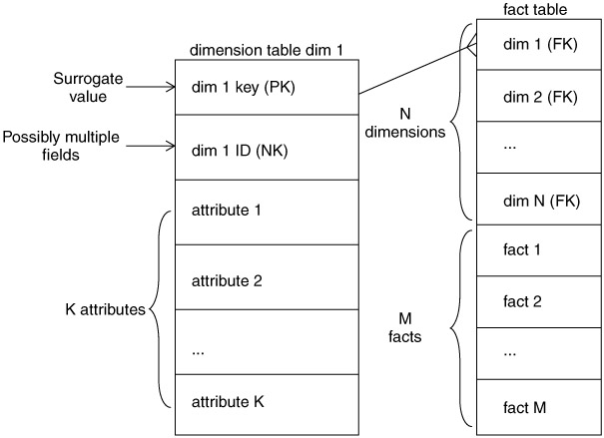
The basic structure of a dimension
Primary key (PK)
Mostly a surrogate key
Foreign Key to Fact Tables
Natural key (NK)
Meaningful key extracted from source systems
1-to-1 relationship to the PK for static dimensions
1-to-many relationship to the PK for slowly changing dimensions, tracks history of changes to the dimension
Descriptive Attributes
Primary textual but numbers legitimate but not numbers that are measured quantities
100 such attributes normal
Static or slow changing only
Product price -- either fact or dimension attribute

Slide 5
Smart keys in place of Surrogate keys
Smart Key
Natural Key concatenated with timestamp
A wrong approach: Reasons
Keys assume responsibility
Changes may happen to natural key, causing the change of all fact table records referring it.
Poor performance
Key may take CHAR or VARCHAR type, comparison is slower.
Joins between two CHAR / VARCHAR is slower process
Heterogeneous source systems
Common dimensions are sourced by different sources.
Conflict arise when second source comes into the scene to source the key.

Slide 6
The grain of a dimension
Grain of the dimension means, the definition of the key of the dimension
The grain of the customer dimension is customer
Verify that a given source (file) implements the intended grain
Nothing should be returned by the following query from the source system/file for the fields A,B & C to form the natural key
If something is returned by this, the fields A, B and C do not represent the grain of the dimension
select A, B, C, count(*) from DimensionTableSource group by
A, B, C having count(*) > 1

Slide 7
The basic load plan for a dimension
Data cleaning
Validate the data, apply business rules to make the data consistent, column validity enforcement, cross-column value checking, row de-duplication
Data conforming
Align the content of some or all of the fields in the dimension with fields in similar or identical dimensions in other parts of the data warehouse
Data Delivery
All the steps required to deal with slow-changing dimensions
Write the dimension to the physical table
Creating and assigning the surrogate key, making sure the natural key is correct, etc.

Slide 8
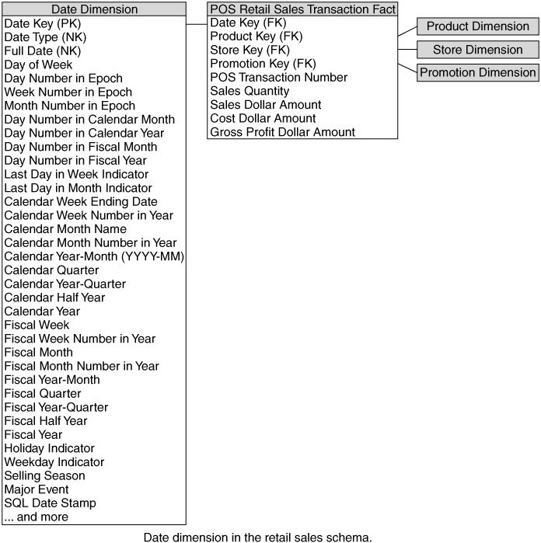
Date and Time Dimensions
Virtually everywhere: measurements are defined at specific times, repeated over time, etc.
Most common: calendar-day dimension with the grain of a single day, many attributes
Doesn’t have a conventional source:
Built by hand, spreadsheet
Holidays, workdays, fiscal periods, week numbers, last day of month flags, must be entered manually
10 years are about 4K rows

Slide 9
Date Dimension
Note the Natural key: a day type and a full date
Day type: date and non-date types such as inapplicable date, corrupted date, hasn’t happened yet date
fact tables must point to a valid date from the dimension, so we need special date types, at least one, the “N/A” date
How to generate the primary key?
Surrogate Keys, whose zero value is assigned to the standard starting date of the history of records
Partition warehouse on date helps improve performance & allows work on the current partition such as, creating & dropping index.
Surrogate key 9999999 may be designed to mean N/A. This high value will keep it always in the current partition.

Slide 10
Other Time Dimensions
If the grain is month, not day, then create a separate dimension table for month. Similarly, if the grain is week or some domain specific span.
Creating month view on the date dimension is not desirable, since it would drag larger table in to the month based query. 120 records will be there for monthly grain dimension table for 10 yrs.
When the grain is seconds, it is not advisable to create 375 million rows per year (approx) for every seconds instead use the design shown.
Date Component
Fact Table
Calendar Date (FK)
Other Dims… (FKs)
SQL data-time
Other facts
Precise Time stamp, not a dimension
This design is preferred over creating a dimension table record for every minutes or seconds

Slide 11
Big and Small Dimensions
BIG
Examples: Customer, Product, Location
Millions or records with hundreds of fields (insurance customers)
Or hundreds of millions of records with few fields (supermarket customers)
Always derived by multiple sources
These dimensions should be conformed
SMALL
Examples: Transaction Type, Claim Status
Tiny lookup tables with only a few records and one ore more columns
Build by typing into a spreadsheet and loading the data into the DW
These dimensions should NOT be conformed
JUNK dimension
A tactical maneuver to reduce the number of FKs from a fact table by combining the low-cardinality values of small dimensions into a single junk dimension.
Generate as you go, don’t generate the cartesian product

Slide 12
Dimensional Roles
The same dimension can be attached to a fact table multiple times
Sale has an order date, payment date, a shipping date, a return date
A claim transaction has multiple internal people, a claim intake, a medical nurse, a claim adjuster, a payer, etc
End-user might be confused when they do drill-down into the dimension as to what the dimension represents, so it helps to have the dimension have different names

Slide 13
The data loading module consists of all the steps required to administer slowly changing dimensions (SCD) and write the dimension to disk as a physical table in the proper dimensional format with correct primary keys, correct natural keys, and final descriptive attributes.
Creating and assigning the surrogate keys occur in this module.
The table is definitely staged, since it is the object to be loaded into the presentation system of the data warehouse.

Slide 14
Type-2 Slowly Changing Dimension
When a record changes, instead of overwriting
create a new dimension record
with a new surrogate key
add the new record into the dimension table
use this record going forward in all fact tables
no fact tables need to change
no aggregates need to be re-computed
Perfectly partitions history because at each detailed version of the dimension is correctly connected to the span of fact tables for which that version is correct

Slide 15
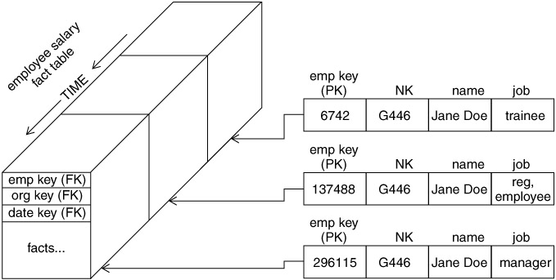
Type-2 Slowly Changing Dimensions
Type-2 do not change the natural key (the natural key should never change)

Slide 16
Type-2 SCD Precise Time Stamping
With a Type-2 change, you might want to include the following additional attributes in the dimension
Date of change
Exact time of change
Reason for change
Current Flag (current/expired)

Slide 17
Type-2 SCD using CRC
For small tables, use a brute force approach of comparing every incoming field with every field in the DW to see if anything changes
For larger tables, use the CRC, or cyclic-redundancy checksum, a number of about 20 digits, like this:
Treat the entire incoming record as a string
Compute the CRC value of the string (some numeric value)
Compare the CRC value of today’s record with the CRC value of yesterday’s record
If the CRC values match, today’s record is identical to yesterday’s record
If the CRC values do not match, do a field by field comparison to see what has changed
Depending on whether the changed field is a Type-1, Type-2 or Type-3 change, do the necessary updates
Most ETL packages and the Internet include CRC computation and comparison code

Slide 18
5. Delivering Fact Tables

Slide 19
Loading facts
Facts
Fact tables hold the measurements of an enterprise. The relationship between fact tables and measurements is extremely simple. If a measurement exists, it can be modeled as a fact table row. If a fact table row exists, it is a measurement

Slide 20
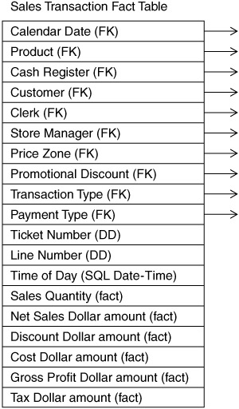
The basic structure of a fact table
Every table defined by its grain
in business terms
in terms of the dimension foreign keys and other fields
A set of foreign keys (FK)
context for the fact
Join to Dimension Tables
Degenerate Dimensions
Part of the key
Not a foreign key to a Dimension table
Primary Key
a subset of the FKs
must be defined in the table
Surrogate keys
Has no business intelligence
Should not be delivered to the users

Slide 21
Key Building Process - Facts
When building a fact table, the final ETL step is converting the natural keys in the new input records into the correct, contemporary surrogate keys
ETL maintains a special surrogate key lookup table for each dimension. This table is updated whenever a new dimension entity is created and whenever a Type 2 change occurs on an existing dimension entity
All of the required lookup tables should be pinned in memory so that they can be randomly accessed as each incoming fact record presents its natural keys. This is one of the reasons for making the lookup tables separate from the original data warehouse dimension tables.

Slide 22
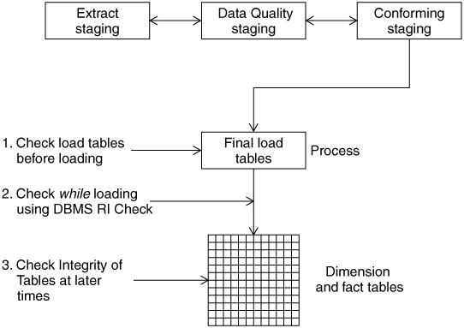
Guaranteeing Referential Integrity
“EVERY FACT TABLE ROW MUST BE FILLED WITH LEGITIMATE FOREIGN KEYS”
Check Before Loading
Check before you add fact records
Check before you delete dimension records
Best approach
Check While Loading
Serious performance issue, while loading thousands of data.
Check After Loading
Theoretically ok, to find all violations
Running query over the entire fact table cause serious performance issues.
If the checking is restricted to data loaded only today, we make an assumption that the date foreign key is reliable

Slide 23
Options for loading the Surrogate Keys of Dimensions
Look up the current surrogate key in each dimension, fetch the record with the most current surrogate key for the natural key and use that surrogate key. Good option but very slow.
Maintain a surrogate key lookup table for each dimension. This table is updated whenever a new record is added or when a Type-2 update occurs in an existing dimensional entity.
The dimensions must be updated with Type-2 updates before any facts are loaded into the Data Warehouse, to guarantee referential integrity

Slide 24
Surrogate Key Pipeline
Assume that all records to be added to the fact table are current, i.e.,
in the incoming fact records, the value for the natural key of each dimension is the most current value known to the DW
When loading a fact table, the final ETL step converts the natural keys of the new input records into the correct surrogate key of the dimensions using the key mapping tables

Slide 25
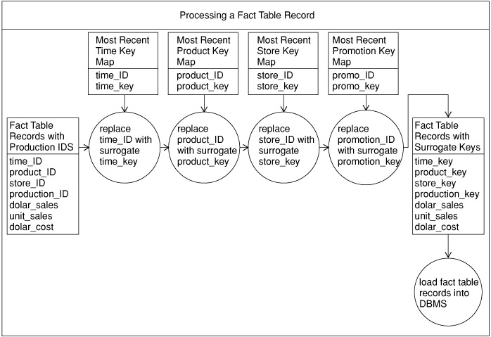
Surrogate Key Pipeline (contd…)

Slide 26
Grains of Fact Tables
Every fact table should belong to exactly one of the following grains
Transaction grain
Periodic snapshot grain
Accumulating snapshot grain

Slide 27
Transaction Grain Fact Tables
The grain represents an instantaneous measurement at a specific point in space and time
retail sales transaction
More detailed fact table
Generally consists of more number of dimensions
Each record correspond to the instant of measurement.
Transactions are time stamped to the nearest second/minutes
Fact table records arrive in batches at regular intervals

Slide 28
Periodic Snapshot Fact Tables
The grain represents a span of time periodically repeated
A periodic snapshot for a checking account in a bank, reported every month
Beginning balance
Ending balance
Number of deposits
Total for deposits
Number of withdrawals
Total for withdrawals
Attributed by more number of facts
Predictable sparseness
one checking account record per account per month

Slide 29
Accumulating Snapshot Fact Tables
The grain represents finite processes that have a definite beginning and an end
Order fulfillment, claim processing, “small workflows”
But not large complicated looping workflows
Example: shipment invoice line item
Order date
Requested ship date
Actual ship date
Delivery date
Last payment date
Return date
Characteristics: large number of date dimensions, data are created and overwritten multiple times as events unfold

Slide 30
Loading a Table
Separate inserts from updates
Identify update records from the bulk data to be loaded and process it first
Perform the insertion of the rest of the records using a bulk loader.
Use a bulk loader
To improve performance of the inserts & decrease database overhead
With many bulk loaders, updating is not possible
Load in parallel
ETL tool supports breaking data in logical segments, say one per year & load the data in parallel
Some ETL tools offers dynamic partition to help bulk loading
Minimize physical updates
To decrease database overhead with writing the rollback logs, delete the records requires update & load it all afresh using bulk loader

Slide 31
Updating and Correcting Facts
Negate the fact
Create an exact duplicate of the fact where all the measurements are negated (-minus), so the measures “cancel” each other in summaries
Do it for audit reasons and/or if capturing/measuring erroneous entries is significant to the business
Update the fact
Delete and reload the fact
Drawback: current versions of previously released reports no longer valid
Physical deletes → the record is deleted
Logical deletes → the record is tagged “deleted”

Slide 32
Graceful Modifications
Modifications to the dimensional schema, without affecting end user applications
Modifications includes
Adding a fact to the existing fact table at the same grain
Adding a dimension to the existing fact table at the same grain
Adding an attribute to an existing dimension
Increasing granularity of existing fact & dimension table
Complicated Job!
Changing weekly grain to daily grain ?
Constraints on weekly aggregation only work with the historical data.
Further additions can be at daily grain

Slide 33
Aggregate tables
Aggregate navigator sits between user query & DBMS, intercepting queries and transforms base level queries into aggregate aware queries wherever possible
Good aggregate program
Provides performance enhancement
Add only reasonable amount of storage
Transparent to the end user
Users are not aware of it.
No user program can refer to aggregation tables directly!
Affect the cost of extract system least possible
Each extract leads to the updation of aggregates!
Not adds much burden to the DBA
Generates metedata automatically

Slide 34
Aggregate tables- Design Requirements
Aggregates must be stored in their own fact tables, separate from base-level data.
Dimension tables attached to the aggregate tables must be shrunken version of the corresponding dimension
The most shrunken version of the dimension is the dimension removed altogether
The base table & all its aggregate tables must be related together as a family of schemas, so that aggregate navigator knows which of the tables are related together
All queries from the users must be forced to refer the base table only.

Slide 35
Review Mid Sem
Data Warehousing-Introduction
Definition
Characteristics
OLTP vs OLAP
Top-down vs. Bottom up approaches to Data Warehousing

Slide 36
Data Warehousing Architecture
Architectural Components of a Data Warehouse
Data Marts
Data Staging
Meta Data

Slide 37
Dimensional Modeling
Dimensional Modelling Vocabulary
ER Modelling vs. Dimensional Modelling
Retail Store Dimensional Model
Slowly Changing Dimensions, Surrogate keys
Factless Fact Tables

